Slide 1

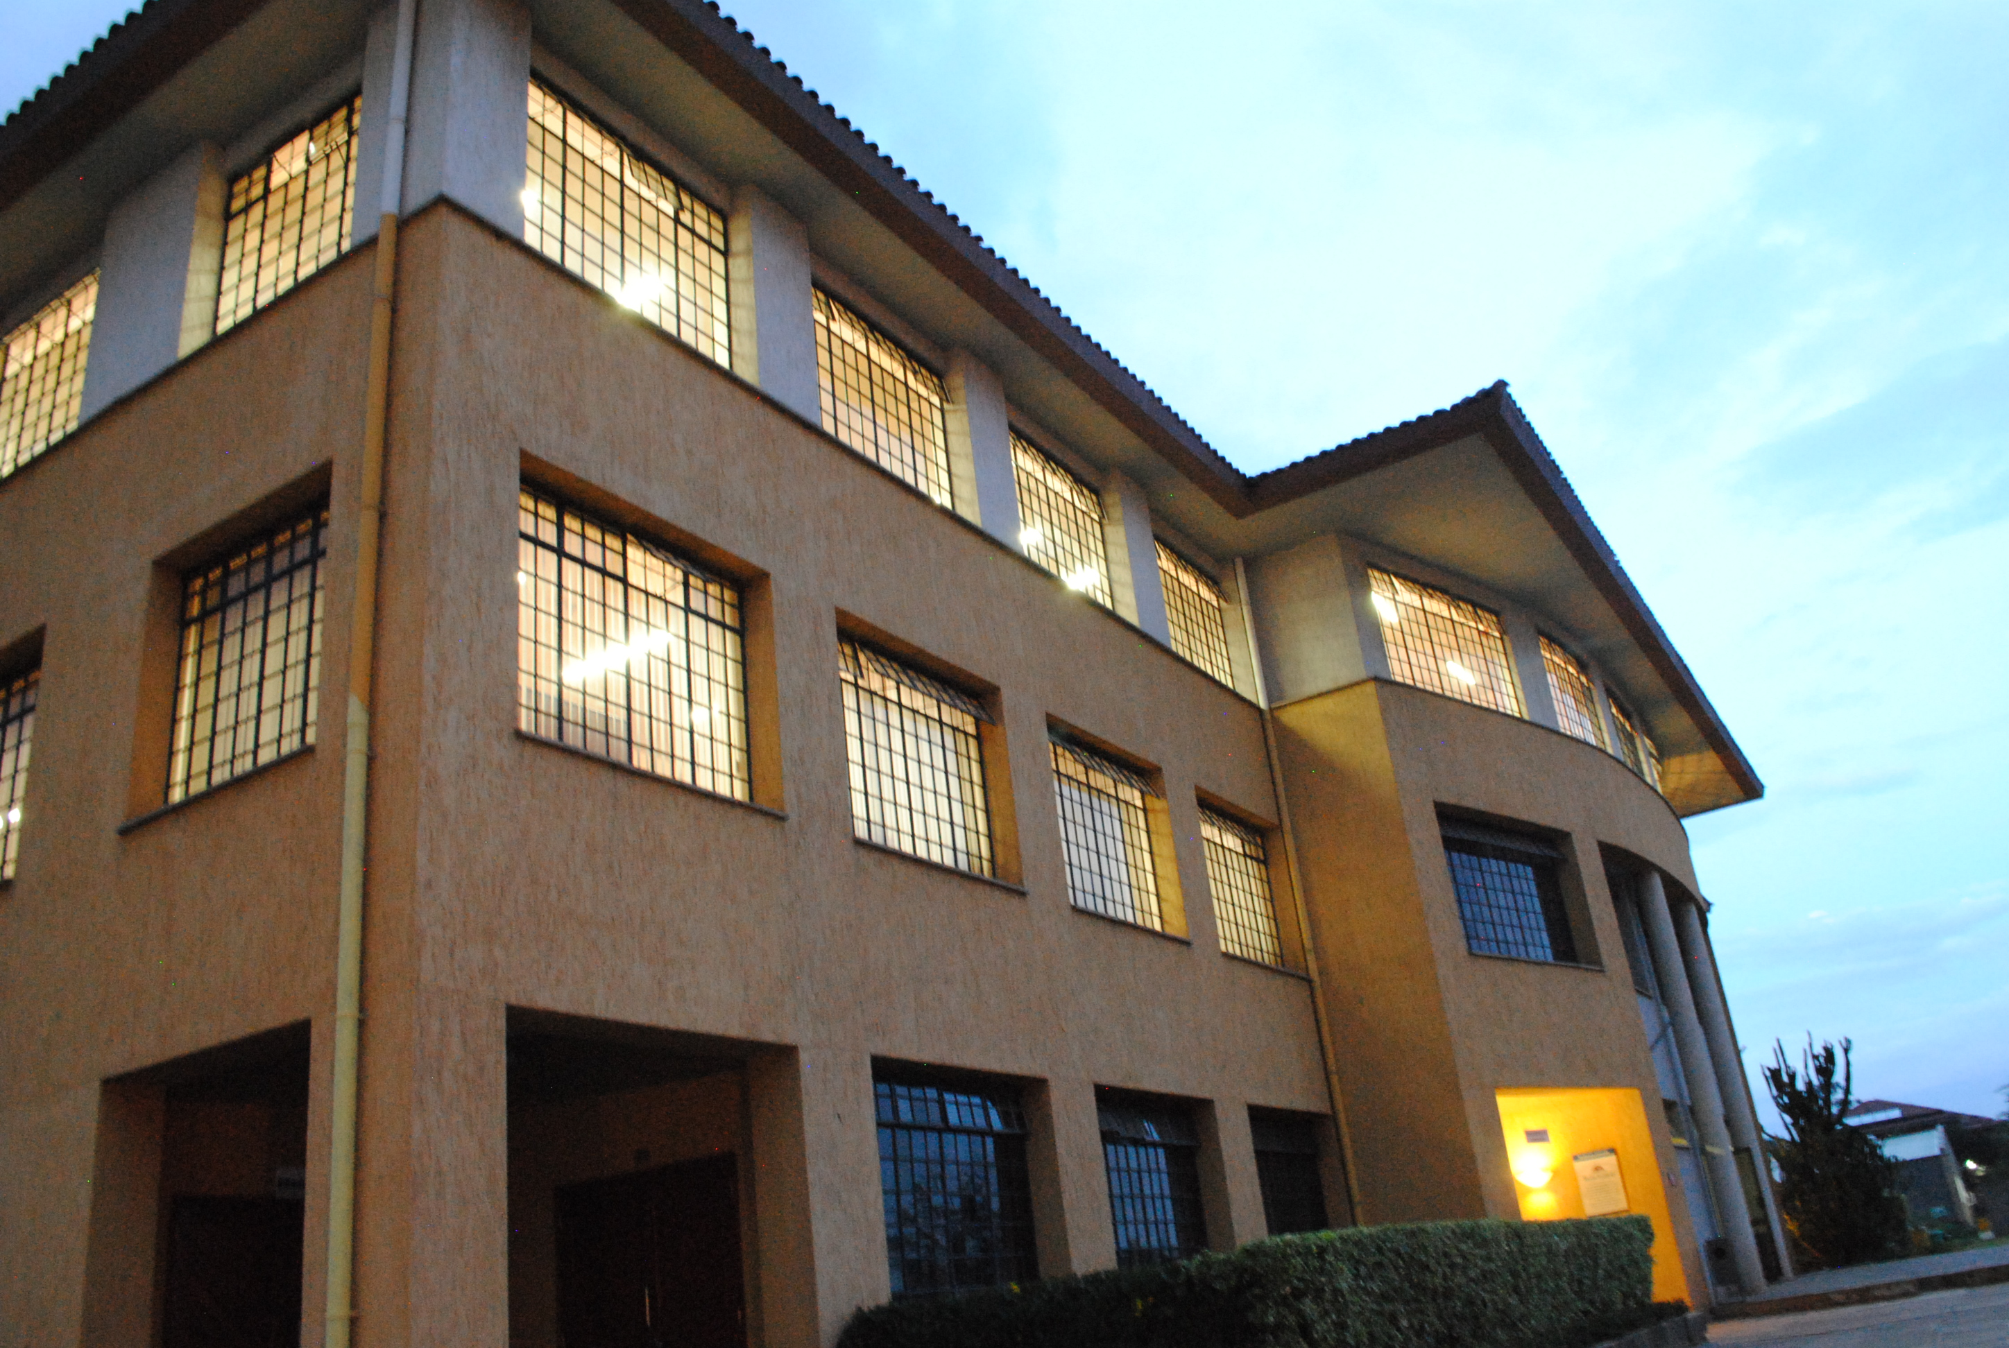

Theory of the Voluntary Act
Principles of Ethics

Slide 2
Learning Outcomes
Explain the nature and the intentional dimension of the voluntary action
Discuss and apply the four characteristics of the human action
Explain the link between the intellect and will in prudent decision-making
Differentiate the types of voluntary human actions
Describe the circumstances which may influence the level of freedom and responsibility in human actions

Slide 3
Overview
Characteristics of human actions
Prudent decision-making in 10 steps
Impediments to knowledge and modifications of free will

Slide 4
Case
Stealing company data before leaving
Read the case and take note of any ethical issues it contains

Slide 5
Characteristics of human actions

Slide 6
What is a voluntary act?
“It is a human act which proceeds from an intrinsic principle with formal knowledge of the goal” (Debeljuh)
What is the intrinsic principle?
What does formal knowledge of the goal imply?

Slide 7

The voluntary act as an intentional act
Intentionality is a characteristic of the acts of the intellect and the will by which the act is open to, is directed towards achieving some goal.
Intellect
GOAL
Will
Brushing my teeth is an
intentional act as I want to
achieve the goal of oral hygiene
because I know it is good for me
and for other people

Slide 8
Characteristics of the voluntary act
Voluntary Act
Conscious
Active
Guided by reason
Self-referential
Example: eating breakfast

Slide 9
Explanation
Conscious: the person knows the goal, establishes the connection between the act and the goal he wants to achieve
  Eating breakfast is “conscious”: my goal is to satisfy hunger and get nourishment; I know that by eating breakfast I will achieve the goal
Active: the person and the goal to be attained enter into relationship with one another through the initiative of the person
  Eating breakfast is “active”: I – the person – act by eating breakfast in order to achieve my goal of satisfying hunger and nourishing myself

Slide 10
Explanation
Guided by reason: the intellect knows the reason which moves the person to want to do the good act in order to achieve the goal
  Eating breakfast is “guided by reason”: I know that it is good for me to eat breakfast so that I satisfy my hunger and I have the nutrients I need for the day
Self-referential: the voluntary act has the person as its goal because it has an impact on the person who carries it out
  Eating breakfast in “self-referential”: when I freely eat breakfast, I satisfy my own hunger and I obtain the nutrients I need for myself

Slide 11
Individually or in pairs
Identify a voluntary act that you carried out recently
Briefly describe the action in writing
Analyse the action and explain how it was
  Conscious
  Active
  Guided by reason
  Self-referential

Slide 12
Types of Voluntary Acts
Perfectly voluntary:
Full knowledge and consent
Imperfectly voluntary:
Imperfect knowledge and/or imperfect consent
Involuntary:
No knowledge or consent
Mixed acts/double effect:
Direct object known + wanted AND indirect object known but not wanted
Omission:
Know + choose not to act OR abstain from any decision/action

Slide 13
Types of Voluntary Acts
1. Perfectly voluntary:
  Full knowledge and consent
  To come to class [full knowledge and full consent]
2. Imperfectly voluntary:
  Imperfect/partial knowledge and/or imperfect/partial consent
  To ship faulty servers [full knowledge + partial consent]
  To unknowingly ship faulty servers [partial knowledge + full consent]
3. Involuntary:
  No knowledge and no consent
  To knock into a person passing by as you leave a room [no knowledge they were passing by and no will to knock into them]

Slide 14
Types of Voluntary Acts
4. Mixed acts/double effect/indirectly voluntary:
  An act that you know will have two effects, a good effect that is known + wanted AND a bad effect that is known but not wanted
  Buy a more expensive toiletry than usual: the desired good effect may be the enjoyment of the item; the unwanted bad effect is having less cash to cover expenses for the rest of the month
5. Omission [voluntary inactivity – not doing something you ought to do]:
  Knowingly + willingly choose not to act OR abstain from any decision/action
  Omit to inform your colleague that the Internet is not working as she sets up her laptop for an online meetig
    You know it’s not working + you choose not to tell her
    You abstain from deciding what to do in the situation

Slide 15
Activity
BHM/BTM: identify a specific example for each of the following acts
  #Perfectly voluntary
  #Imperfectly voluntary
  #Omission
BFS: identify a specific example for each of the following acts
  #Involuntary
  #Mixed act
  #Omission
POST EXAMPLES ON POE WHATSAPP GROUP USING THE #
BE ABLE TO EXPLAIN WHY THE ACT IS PERFECTLY, IMPERFECTLY VOLUNTARY, ETC.
TIME-FRAME – 5 MINUTES

Slide 16
Prudent decision-making

Slide 17
Main issue
To make prudent decisions, we need to know how the human intellect and will interact with each other in the process

Slide 18
Reflection
Coming to class today
Did it involve your intellect?
Did it involve your will?
How?
How?

Slide 19
Think and Write
I came to class today
I used my intellect to know that it is good for me to come to class even though I felt tired after a long day at work
I used my will to want to come to class and actually reach class because I knew it was good for me, even though I didn’t feel like doing it
Intellect and Will
How do the intellect and will interact with each other in voluntary actions and decisions?

Slide 20
At a basic level
I see a nice phone
My intellect evaluates if the phone is good or bad
My intellect judges the phone is good for me
My will is attracted to the good phone
My will moves me to want the good phone
My intellect presents the phone as good to my will

Slide 21
Object of the human intellect
What does the intellect aim for?
FACULTY
HUMAN INTELLECT
WHAT? [OBJECT]
THE TRUTH
ACT: TO KNOW

Slide 22
Object of the human will
What does the will aim for?
WHAT?
[OBJECT]
THE GOOD
THINGS
PEOPLE
HUMAN FACULTY
HUMAN WILL
ACT = TO WANT

Slide 23
Object of the Will
DIRECT OBJECT
INDIRECT OBJECT
The good goal known and understood by the intellect and which the will wants to obtain
The principle aim you have in carrying out an action
Graduate with SIMS degree
An indirect effect / consequence of an action
May be foreseen and permitted as inevitably linked to what is known and wanted directly
Not necessarily willed / wanted in itself
Hard work; pay fees; learning; better job opportunities;

Slide 24
Example
You need to buy something urgently at the nearby supermarket so you take the only car your family has and you go to the supermarket without telling any of the people you live with. When you get home 30 minutes later, you discover that your Dad needed the car to visit a sick friend and is angry that it disappeared without anyone telling him.
  1. Which is the voluntary act?
  2. What is the direct object of the will/act?
  3. What is the indirect object of will/act?

Slide 25
Intellect and will in decision making
Intellect
Will
Needs to know the truth about the real goodness or badness of things that appear good to us
To guide the will correctly towards what is best for the person
The intellect needs to be well informed
Needs to be developed and made strong
To always choose the real, true and greatest good thing
Knowing what is truly good, practice freely choosing the best good
To develop true self-mastery

Slide 26
Decision-making and Prudence
A good habit [virtue] which enables us to identify the best way of acting in any given situation
Necessary for good decision-making
A skill which can be developed over time
Requires thought, small decisions, to reach the final main decision – best way of acting

Slide 27
Prudent decisions: engage intellect and will in 10 steps
ACTS OF THE INTELLECT
ACTS OF THE WILL
1. First apprehension of the goal
  Know possible goal
  Travel upcountry
3. Judgement on the goal
  Evaluate real possibility of achieving goal
  It is possible to travel upcountry
2. Simple volition
  Basic agreement of will
  Good idea to go upcountry
4. Intention
  Agreement of will to achieve/reject possible goal
  Ok – let’s plan to go upcountry

Slide 28
Prudent decisions: engage intellect and will in 10 steps
ACTS OF THE INTELLECT
ACTS OF THE WILL
5. Deliberation about means = options
  Reflection on various options to achieve goal
  Which options are available to go upcountry?
  Walk
  Boda boda
  Bus
  Personal car
6. Consent
  Acceptance / rejection of various specific and possible options
  Accept or reject each possible options to go upcountry
  Reject walking
  Reject boda
  Provisionally accept bus
  Provisionally accept car

Slide 29
Prudent decisions: engage intellect and will in 10 steps
ACTS OF THE INTELLECT
ACTS OF THE WILL
7. Judgement for choosing
  Identify most appropriate option to achieve goal
  Between bus and personal car, which is the best way to go upcountry?
  Cost, time, etc.
  Judgement: bus is best means
9. Command
  Plan how to implement chosen option
  Plan to book bus tickets
  Plan to get to bus station
  Plan to take the bus and go upcountry
8. Choice
  Definitive choice to use a specific means / option to achieve goal
  Reject personal car
  Choose the bus
10. Active use of will to implement chosen option
  Actually book bus tickets
  Actually get to bus station
  Actually take the bus and go upcountry
OUTCOME = END GOAL OBTAINED: ENJOY THE VISIT UPCOUNTRY

Slide 30
Groupwork: 10-step analysis
Apply the 10 steps using intellect and will to Mr Troy’s situation in the Stealing Company Data case to identify the most prudent way to respond to the problem of losing his job
Share in class

Slide 31
10 step analysis for prudent decision-making
ACTS OF THE INTELLECT
ACTS OF THE WILL
1. First apprehension of the goal
  Know possible goal
3. Judgement on the goal
  Evaluate real possibility of achieving goal
5. Deliberation about means
  Reflection on best means to achieve goal
7. Judgement for choosing
  Identification of most appropriate means
9. Command
  Plan how to implement means to achieve goal
2. Simple volition
  Basic agreement of will
4. Intention
  Agreement of will to achieve/reject possible goal
6. Consent
  Acceptance / rejection of various specific and possible means
8. Choice
  Definitive decision to achieve goal
10. Active use of will to achieve the goal
Enjoy the goal obtained

Slide 32
Impediments to knowledge and modifications of free will

Slide 33
Freedom and responsibility in human actions
In principle, we are responsible for the human actions we carry out knowingly and willingly
We know what we are doing and we want to do it
So we can be held accountable for these actions
  We are responsible for them

Slide 34
Modification of freedom and responsibility
In some circumstances, the levels of knowledge and free will in human actions may vary
This can reduce or nullify our freedom in carrying out the action
Thus modifying or nullifying our responsibility for the action

Slide 35
Key modifying circumstances
Lack of awareness / consent: types of voluntary actions
Ignorance
Influence of the passions
Moral habits
Violence
Fear
Mental illness
Find out about the assigned circumstance and explain how it can affect the levels of freedom and responsibility for our actions
using a specific example

